Slide 1


CEEC and CEEC Overseas Investment Division
in South America
October 2025

Slide 2
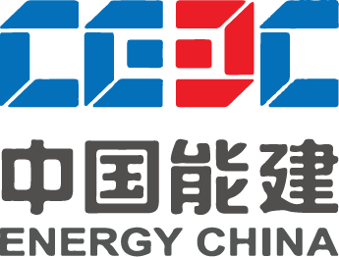
CEEC - Who We Are
11th
+120.000
Energy’s China
Core Businesses
International employees
Contractor
2nd
416
Energy Integration Solutions Provider
General Contractor
Eco system restoration solution provider
Integrated Urban Developer
Building & Industrial Materials supplier
Infrastructure Investor
Global ENR-rated
engineering company
Projects currently under construction
256
239th
Branches
around the world
Place in Fortune Global 500 list
147
+50B USD
Countries
In revenues in 2023

Slide 3
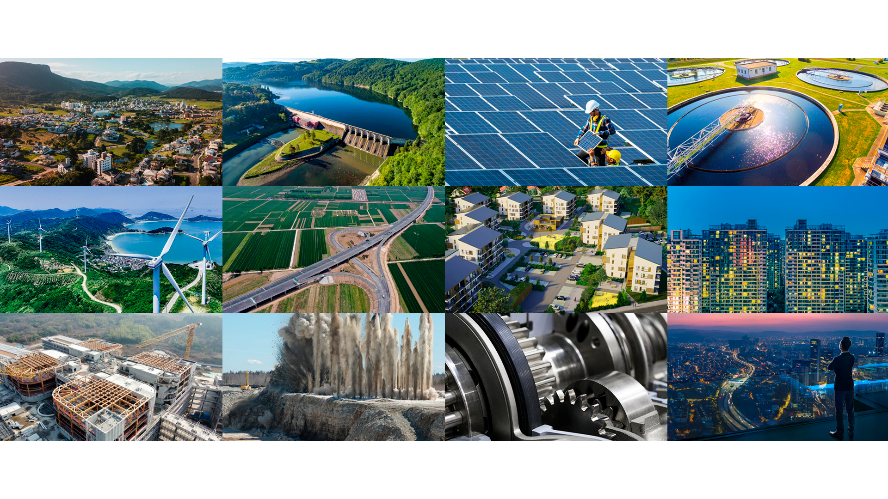
CEEC - What We Do
MUNICIPAL DEVELOPMENT
TRADITIONAL ENERGY
SMART ENERGY SYSTEM
WATER TREATMENT
ENVIRONMENT PROTECTION
INTEGRATED TRANSPORTATION
HOUSING CONSTRUCTION
REAL STATE
BUILDING MATERIALS
CIVIL EXPLOSIVES
EQUIPMENT MANUFACTURING
CAPITAL & FINANCE

Slide 4
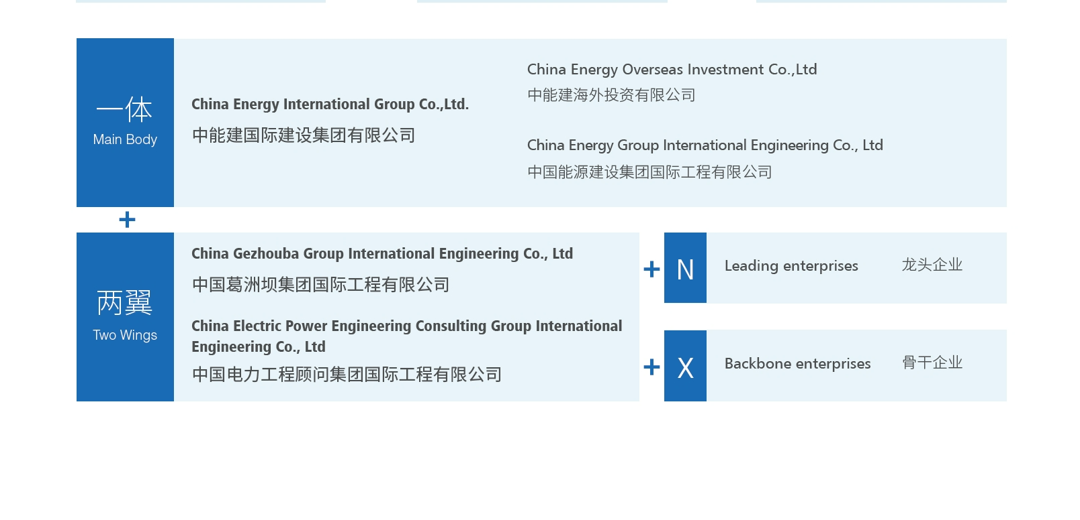
CEEC OIC – The Investment & Asset Management arm for Overseas Projects
Notes:
中能建国际建设集团有限公司（简称 “国际集团”）是中国能建的全资子公司，于 2021 年成立，代表中国能建归口管理国际业务发展，担负海外投资、市场开发、项目实施和监管等方面的引领统筹职能。国际集团作为中国能建系统构建“一体两翼” 海外发展体系中的“一体”，负责组织实施中国能建海外优先发展战略、统筹国际业务和市场布局、协调海外品牌建设和高端市场营销、强化海外风险管控和合规体系建设，引领中国能建十二大业务全面出海。

Slide 5
CEEC OIC – The Investment & Asset Management arm for Overseas Projects
Founded in Beijing in 2016 CEECOIC serves as a specialized platform for overseas investment on behalf of Energy China.
CEECOIC benefits from Energy China's robust capabilities across the entire industry chain, encompassing planning, engineering, construction, equipment supply, and operation.
This enables the Company to offer integrated energy and infrastructure enhancement solutions to its clients, positioning itself as a premier investor and developer in the global infrastructure arena.
CEECOIC focus are in Green Energy, Green Water management, and Green urban developments projects opportunities
7 BUSD
Investments to date
27
27 Overseas Subsidiaries

Slide 6

CEEC OIC – Strategic Positioned in Key Markets
High-level market
Traditional advantageous market
Gradually break through and expand into high-end markets such as Western Europe, Oceania, and North America, providing strong support for the company's business model transformation and enhanced internationalization capabilities.
Actively promote established beneficial markets like Southeast Asia, South Asia, and Central Asia within the framework of the Belt and Road Initiative, while upholding a strong commitment to sustainable development practices.
Mid-level market
Emerging market
Proactively encourage market growth in Central and Eastern Europe, the Middle East, and Latin America, engage in diverse mergers and acquisitions as well as investment opportunities, and secure a presence in mid-to-high-end markets.
Develop the African market with high precision, select countries in Africa with favorable investment conditions, and explore emerging markets through effective means.

Slide 7
CEEC OIC - Main Business Areas
Green Energy
Green Water
In the Green Energy sector, we prioritize investments in renewable energy, hydrogen energy, energy storage, and the enhancement of power systems
In the realm of Green Water initiatives, we emphasize investments in sewage treatment, domestic water supply, and seawater desalination.
Green Cement
In the Green Urban industry, our emphasis is on investing in cements that generate lower carbon emissions and require less energy per unit.

Slide 8
CEEC OIC - Technological Innovation
Integrated Hydrogen
Energy
Seawater
Desalination+
New type Energy Storage
科创数智
Smart
Technologies
Fostering scientific and technological advancements
Enhancing digital and intelligent capabilities.
Ventures in areas such as advanced energy storage (BESS), integrated hydrogen energy, seawater desalination, and Smart Systems, among other strategic emerging sectors.

Slide 9
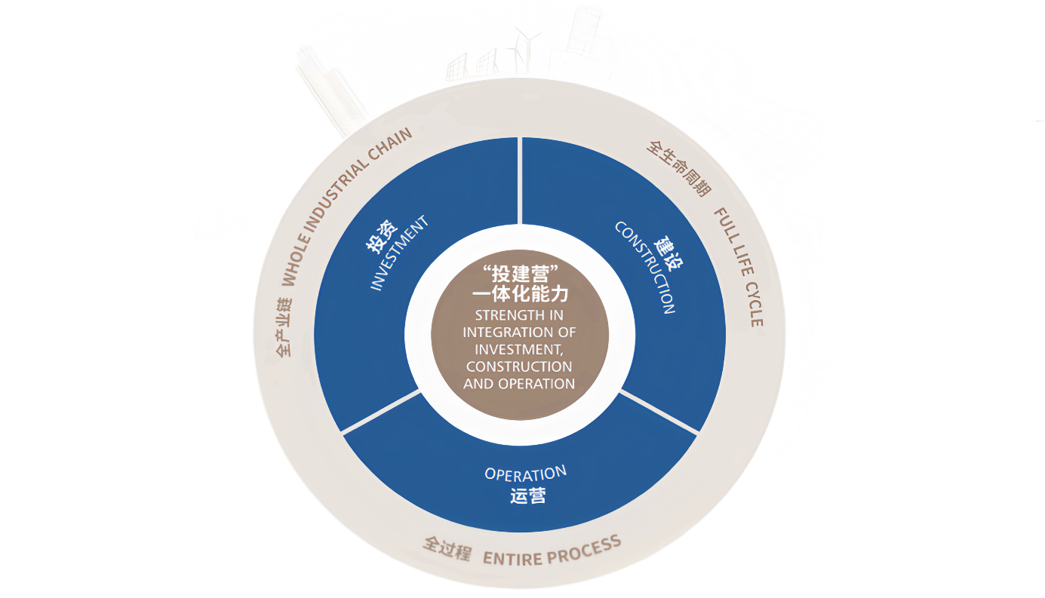
CEEC OIC - The Integration Advantage: Investment + Construction + Operation
Advantage in carrying out investment, construction and operation, as an integrated solution
We provide solution througout the whole project life cycle.

Slide 10
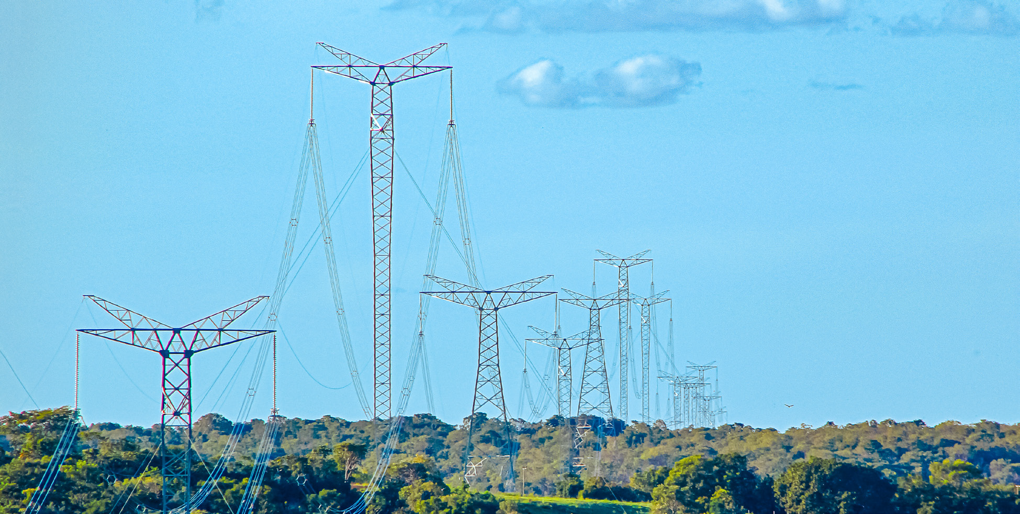







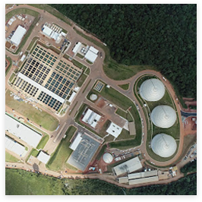
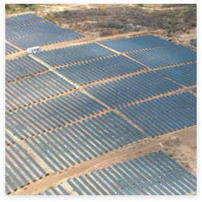
CEEC - History in Brazil
Acquired SPSL PPP
and started operations
A USD 980M deal
2018
Kicked off Brazil expansion w/ focus on Energy and Water
2023
2024
2013
Stablish office in Sao Paulo
Current Focus:
2019 / 2023
Awarded Belo Monte & Rota 3
Transmission Line Engineering Site Survey
Technology: Renewable Energy . Energy H2V . Water BESS CAES Water treatement
Waste to Energy
Services Engineering
EPCM services Equipment supply

Slide 11
CEEC in South America
Energy China
EPC Energy & Infrastructure
Equipment Services
Investment & Asset Management
CEIG South America
Others
CEEC OIC Brazil (also Chile & Colombia)
Projects
Projects
Water Business
Energy
Business

Slide 12
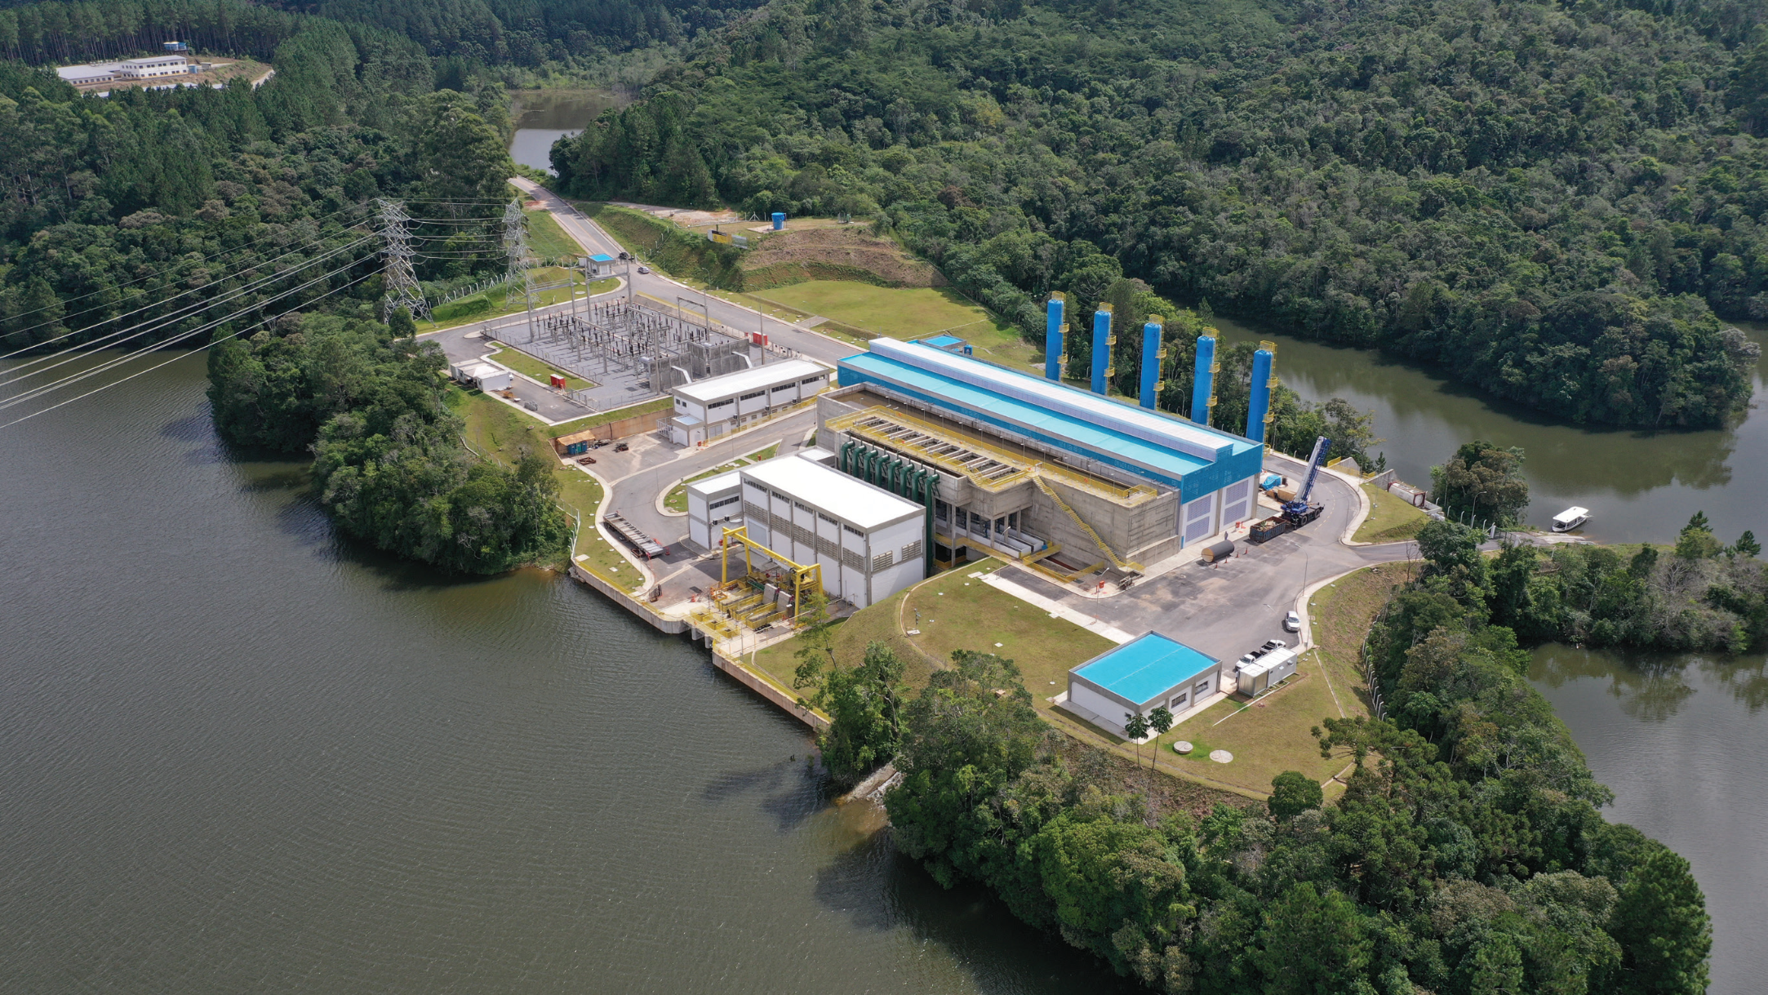
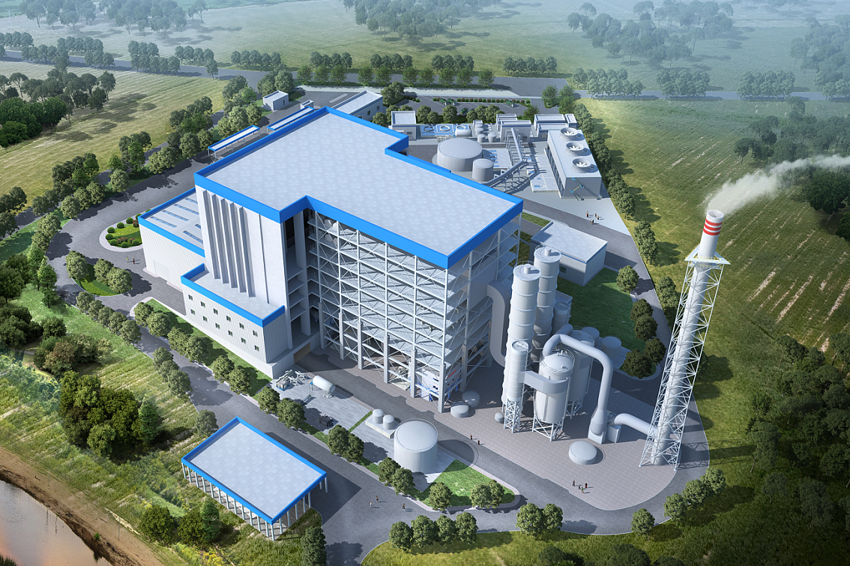
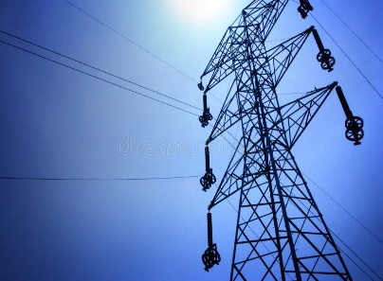
CEEC Brazil - Track Record
Belo Monte
800kV UHV DC TL
Transmission Line Project, Brazil (Survey & Engineering)
2020 - Brazil
Brazil's first and world's fourth ±800kV UHV DC TL
Sistema Produtor São Lourenço
USD 970 million investment in water treatment system.
2018 - Brazil.
25 years concession
Plant in operation phase Supplying approximately 2 million inhabitants in the western part of the Metropolitan Region of São Paulo.
Barueri 19.1 MW Waste to Energy Plant
Garbage power station Engineering
2023 – Brazil
The first solid waste power plant in Brazil & the largest in Latin America
Capacity: 300,000 t/year
In execution, COD in 2026
800kV UHV DC TL
Lote1 – 1B – TL3
Transmission Line EPCM for State Grid Rota 3
2024 – Brazil
A 230 km, 800 kV ultra-high voltage transmission concession

Slide 13
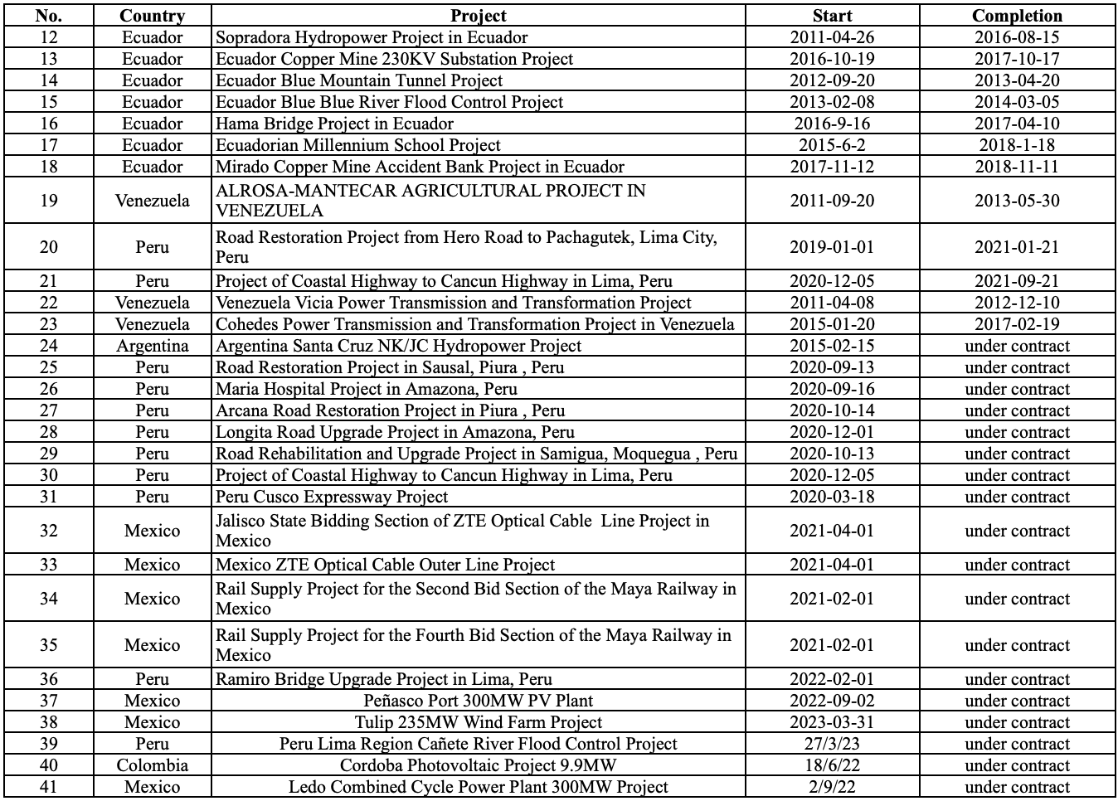
CEIG Internacional – EPC track record in the region

Slide 14
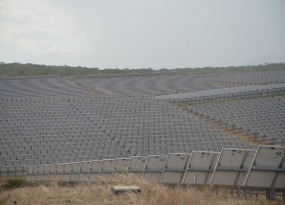
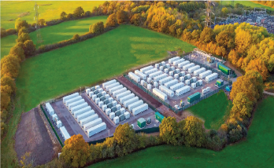
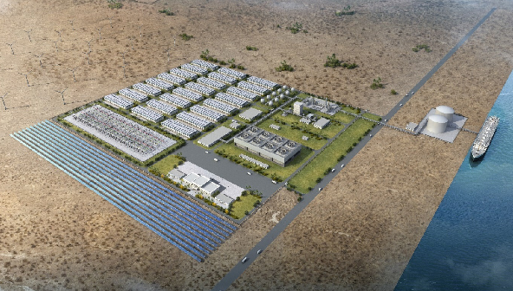
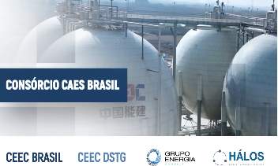
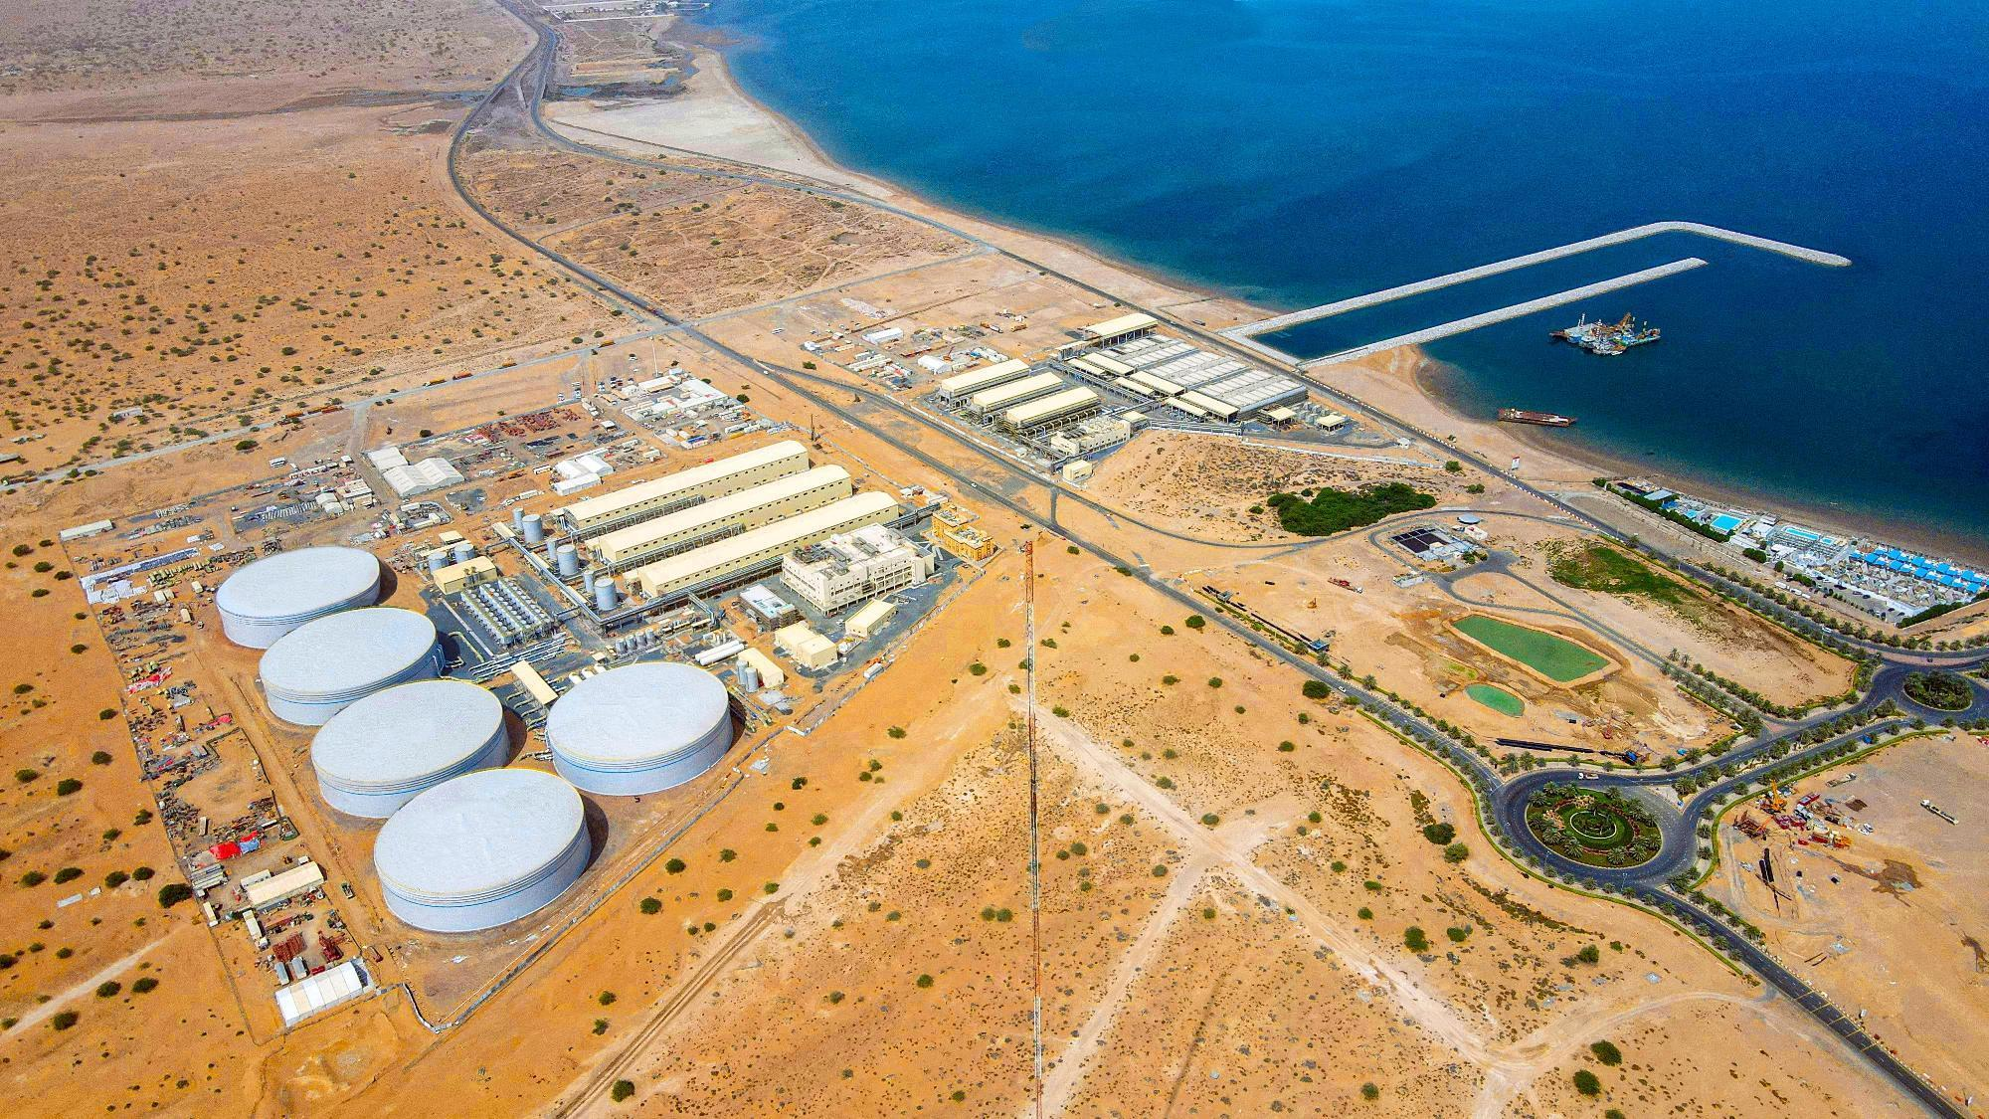
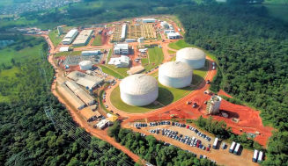
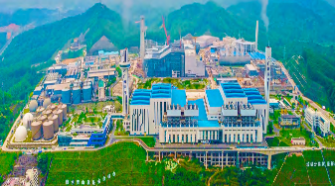

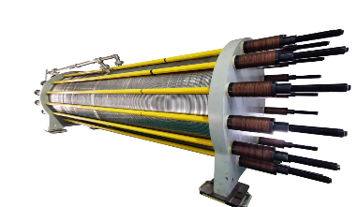
CEEC South America – Strategic Focus
M&A Solar / Wind Brownfield and Greenfield
Developing
BESS
Solutions
Developing
Green H2 Ammonia Plants
Developing CAES Compressed Air Energy Storage Solutions
Desalinization Projects
M&A and PPPs
for
Water systems
Developing
Waste to Energy Solutions
Enginerring / EPC Services
(CEIG)
Equipment offers: (CEIG)

Slide 15
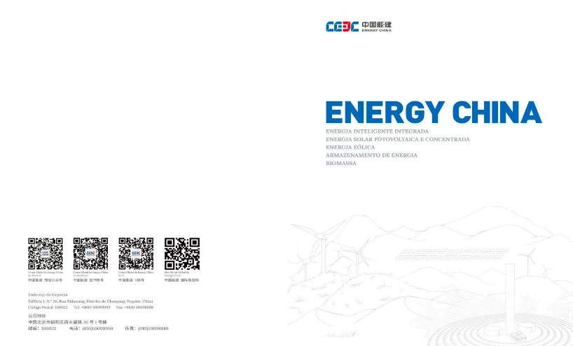
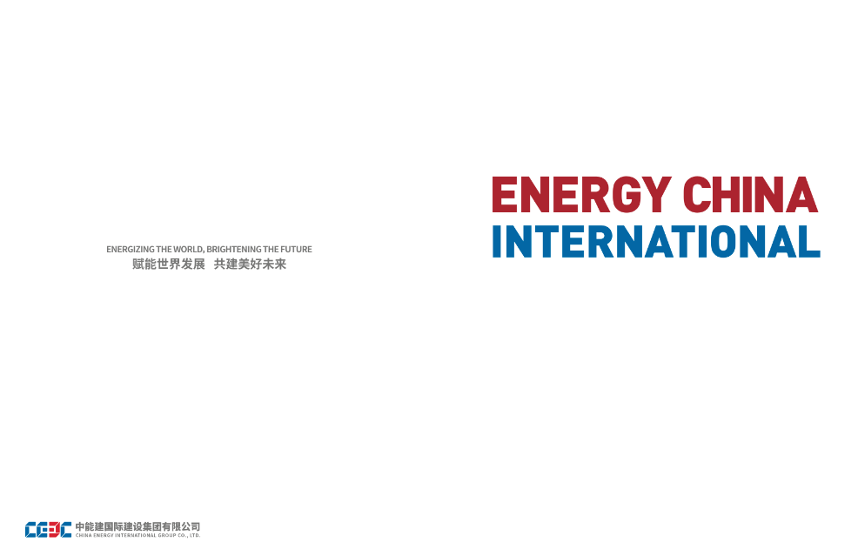
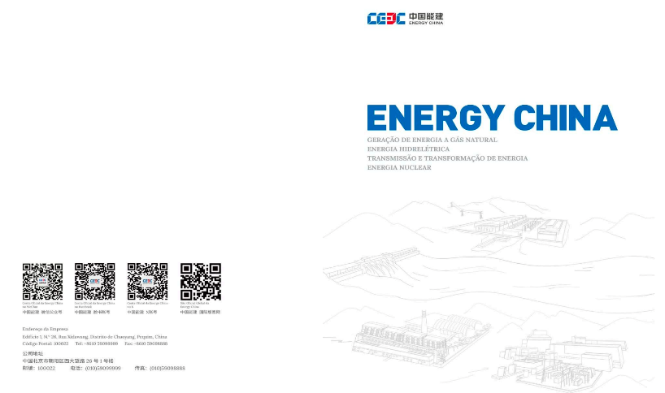
Folders

Slide 16
CEEC OIC principles for Business in South America
CEEC will develop, invest and operate for the full cycle of the project
CEEC will seek to use local suppliers e.g. construction companies and O&M services providers, as required
CEEC can have partnerships during development phase and construction up to COD, however must have full control at the operation stage
Finance can be sourced locally or internationally depend on the currency of PPA
During the due diligence we will source finance, legal, and technical advisors locally in Chile
Focus on B&B relationship
Exclusivity must be in place
It is important to stress CEEC has a comprehensive approval process which all opportunities will need taken upon in China

Slide 17


